Slide 1
All Manufacturer Technical Electric Hybrid Water Heater (EHWH) Training
Helping Consumers Make the Best Water Heating Decisions
Links & Resources
Notes:
P0001
Point of Slide: Introduction to All Manufacturer Technical Electric Hybrid Water Heater (EHWH) Training – Helping your customers make the best water heating decisions

Slide 2
Table of Contents
Page 1 – Title Page
Page 2 – Table of Contents
Page 3 – Hot Water Solutions Resource Links & Contact Information
Page 4 – Manufacturer Resource Links & Contact Information
Pages 5-6 – Qualified Products List
Page 7 – Product Compatibility: Sizing Considerations
Page 8 – Tank Attribute Overview
Page 9 – Tank Selection Criteria
Pages 10-11 – Specifics by Brand
Page 12 – Brand Model Dimension Specifics
Page 13 – Space Heat Interaction
Page 14 – Installation Considerations: Open Basement
Page 15 – Installation Considerations: Garages
Page 16 – Cold Climate Zones
Pages 17-18 – Exhaust-Only Ducting Energy Savings Comparison
Pages 19-21 – Volumetric Constraint Testing
Page 22 – Noise
Page 23 – Noise Mitigation
Page 24 – Brand Naming Convention
Page 25 – Thank You
Notes:
P0125
Point of Slide: Provides information and resources for available utility rebate programs

Slide 3
Hot Water Solutions Resource Links & Contact Information
Hot Water Solutions Consumer Resource Center
http://hotwatersolutionsnw.org/
Hot Water Solutions Partner Resource Center
https://hotwatersolutionsnw.org/partners
Utility EHWH Rebate Programs
hotwatersolutionsnw.org/participating-utilities
Hot Water Solutions Contact Information
Email: info@hotwatersolutionsnw.org
Phone: (888) 444-8962
Notes:
P0130
Point of slide: Provide follow up materials and resources

Slide 4
Manufacturer Resource Links & Contact Information
A. O. Smith
https://www.hotwater.com/
Support – (877) 552-0010
Training - https://university.hotwater.com/contact/
Sales Representatives - https://www.hotwater.com/where-to-buy/trade-professionals/
Distributors -https://www.hotwater.com/where-to-buy/search/
User Manuals - https://www.hotwater.com/resources/product-literature/instruction-manuals/residential-electric/
Spec Sheets - https://www.hotwater.com/resources/product-literature/spec-sheets/residential-electric-(uef)/
Bradford White
https://www.bradfordwhite.com/forthepro
Support – (800) 523-2931
Training – https://www.bradfordwhite.com/training/
Sales Representatives – https://www.bradfordwhite.com/rep-locator/
Distributors - https://www.bradfordwhite.com/resources-for-professionals-wholesaler/
User Manuals & Spec Sheets - https://www.bradfordwhite.com/documentation/usa/residential/tank-type-gas
Rheem
https://my.rheem.com/
Support – (800) 621-5622
Training – https://www.rheemacademy.com/
Sales Representatives – https://www.rheem.com/find-a-pro/
Distributors – https://www.rheem.com/find-a-pro/
User Manuals & Spec Sheets - https://www.rheem.com/products/residential/water-heating/heat-pump-water-heaters/
Notes:
P0121
Point of slide: Provide contact information and resources of all three EHWH manufacturers

Slide 5
Qualified Products List
Table 1. Integrated HPWH Product Tier Overview
Tier | Minimum Cool Climate Efficiency (CCE) | Minimum Features | Sound Levels
Tier 1.0 | 2.0 | ENERGY STAR compliance Freeze protection | dBa < 65
Tier 2.0 | 2.3 | Tier 1 plus: Minimal use of resistance heating elements (see Section 5.1) Compressor shut-down/notification 10 year warranty Condensate management | dBa < 60
Tier 3.0 | 2.6 | Tier 2 plus: Simultaneous intake and exhaust ducting capabilities Air filter management Override and default mode behavior as per Section 6.1 | dBa < 55
Tier 4.0 | 3.0 | Tier 3 plus: Physical design or default controls that limit resistance element heating to less than upper 50% of tank | dBa < 50
Tier 5.0 | 3.5 | Tier 4 plus: No resistance element usage in default | dBa < 50
https://neea.org/our-work/advanced-water-heating-specification
Notes:
P0006
Point of Slide: Provide guidance for contractors to understand product tiers, and the differences between them

Slide 6
Qualified Products List (cont.)
Table 2. Split-System HPWH Product Tier Overview
Tier | Minimum SCOP* | Minimum Features | Sound Levels
Tier 1.0 | 2.1 | ENERGY STAR compliance Freeze protection | dBa < 65
Tier 2.0 | 2.4 | Tier 1 plus: Minimal use of resistance heating elements (see Section 5.1) Compressor shut-down/notification 10 year warranty Condensate management | dBa < 60
Tier 3.0 | 2.7 | Tier 2 plus: Override and default mode behavior as per section 6.1 | dBa < 50
Tier 4.0 | 3.1 | Tier 3 plus: Physical design or default controls that limit resistance element heating to less than upper 50% of tank | dBa < 50
Tier 5.0 | 3.6 | Tier 4 plus: No resistance element usage in default mode unless outside ambient air temperature is below -5°F | dBa < 50
* SCOP (seasonal coefficient of performance) is a different variable from CCE. SCOP applies to split systems for which the heat pump is subject to outdoor air conditions (see Appendix B.4). The reference climate for the SCOP comprises a combination of the climate of five Pacific Northwestern cities.
https://neea.org/our-work/advanced-water-heating-specification
Notes:
P0007
Point of Slide: Provide guidance for contractors to understand split system tiers, and the differences between them

Slide 7
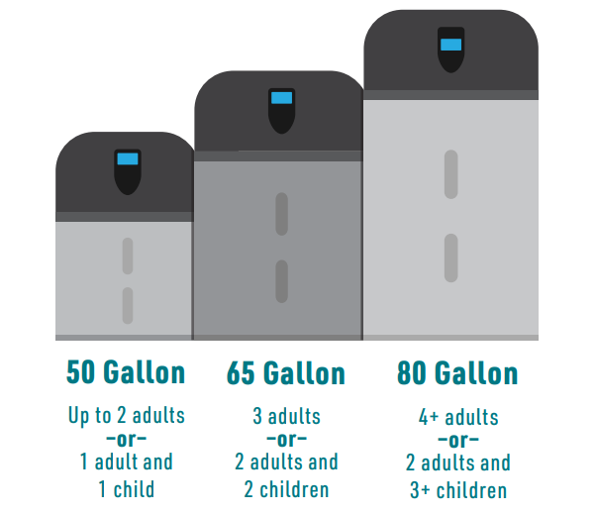
Product Compatibility: Sizing Considerations
The Right Tank for a Household
Size the tank appropriately to meet the household’s needs according to:
Family size
Hot water demand requirements
Installation location
Make sure the water heater can handle the households hot water usage by considering the number of bedrooms and bathrooms in the house.
Plumbing codes specify the size of the tank based on the number of bedrooms and bathrooms in a household and categorize the tank by the first-hour rating — size an EHWH tank for efficiency, and size up.
Notes:
P0022
Point of Slide: Provide recommendations for choosing the right size tank for a household - recommendation to size up a size

Slide 8
Tank Attribute Overview
All attributes below vary depending on specific brand and tank.
Tanks sizes
Heights range from 47 – 79 inches, diameter range from 20 - 27 inches
Volumetric range from 50 gallon, 65 and 66-gallon, 80-gallon
Amperage and breaker requirements
Range from 15 – 30-amp requirements
Operating ranges
A. O. Smith Voltex, 45⁰F to 120⁰F
A. O. Smith Voltex AL, 37⁰F to 120⁰F
Bradford White, 35⁰F to 120⁰F
Rheem, 37⁰F to 145⁰F
Connections
Top or side plumbed
Exhaust
Rear, right-side, or top
Notes:
P0016
Point of Slide: Introduce key attributes of tank selection

Slide 9
Tank Selection Criteria
Space Constraints
Will tank fit into space
Electrical
Amperage of breaker
Ducting (If Required)
Right exhaust
Back exhaust
Wire size
Include duct adaptors if required
Sizing
Include side plumbing
Household size
High usage spa tubs
Possible use of whole house tempering valve
Water Connections
Top-plumbed
Side-plumbed
Notes:
P0017
Point of Slide: Detail inputs for each attribute

Slide 10
Specifics by Brand
Item | Bradford White - AeroTherm | Bradford White – New AeroTherm model* | Rheem | Rheem – 15 amp | A. O. Smith Voltex | A. O. Smith Voltex AL
Volumetric Constraints | 700 ft³ | 700 ft³ | 700 ft³ | 700 ft³ | 450 ft³ | 450 ft³
Clearance Requirements (mostly EHWH) | 8 inches for filter: Don’t block exhaust air. 50-gallon units requires 2” clearance | 8 inches for filter: Don’t block exhaust air. 50-gallon units requires 2” clearance | 8 inches for filter: Don’t block exhaust air | 8 inches for filter: Don’t block exhaust air | Don’t block exhaust air | Zero on back and sides
Expansion Tank Requirements | Required | Required | Required | Required | Required | Required
Duct Adaptor Required | Required | Required | Required | Required | Required | No, built in
Max Length of 8” Duct Flex | 100 equivalent lineal feet | 100 equivalent lineal feet | 125 equivalent lineal feet | 125 equivalent lineal feet | 50 equivalent lineal feet | 100 equivalent lineal feet
Grounding Requirement | Required | Required | Required | Required | Required | Required
Check recent manufacturer product sheets for most up-to-date information. Manufacturers are currently evaluating their space-requirement recommendations, be sure to check with individual manufacturers on latest installation guidance (updated as of 8/18/2022)
*The new Bradford White AeroTherm (Tier 4 model) is expected to be available to the market in 2023 – above product details represented are subject to modification.
Notes:
P0018
Point of Slide: Detail brand specific attributes

Slide 11
Specifics by Brand (cont.)
Item | Bradford White AeroTherm | Bradford White (new AeroTherm model*) | Rheem – 30 amp | Rheem – 15 amp | A. O. Smith Voltex | A. O. Smith Voltex AL
Breaker and Wire Size Requirements | 25 amp | 30 amp | 30 amp | 15 amp | 30 amp | 30 amp
Exhaust Discharge | Rear | Rear | Right | Right | Right | Top
Operating Range | 35°F to 120°F | 35°F to 120°F | 37°F to 120°F | 37°F to 145°F | 45°F to 120°F | 37°F to 120°F
Notes | Good fit for manufactured homes and homes with 25 amp brakers |  |  | No element
Check recent manufacturer product sheets for most up-to-date information. Manufacturers are currently evaluating their space-requirement recommendations, be sure to check with individual manufacturers on latest installation guidance (updated as of 8/18/2022)
*The new Bradford White AeroTherm (Tier 4 model) is expected to be available to the market in 2023 – above product details represented are subject to modification.
Notes:
P0019
Point of Slide: Detail brand specific attributes

Slide 12
Brand Model Dimension Specifics
Manufacturer | Model # | Height (in.) | Diameter | FHR | Shipping Weight
A. O. Smith Voltex | HPTU-50N | 63 | 22 | 66 | 196
 | HPTU-66N | 61 | 27 | 79 | 289
 | HPTU-80N | 79 | 27 | 86 | 307
A. O. Smith Voltex AL | HPTS-50 | 63 | 22 | 65 | 196
 | HPTS-66 | 61.5 | 26.5 | 82 | 289
 | HPTS-80 | 80 | 26.5 | 95 | 303
Bradford White AeroTherm | RE2H50S10 | 47 | 21 & ¾ | 65 | 195
 | RE2H65T10 | 63 & ¾ | 25 | 77 | 236
 | RE2H0T10 | 71 | 25 | 87 | 259
Bradford White (new AeroTherm model*) | RE2H50S10 | 59 & $3/{16}$ | 21 & ¾ | 65 | 195
 | RE2H65T10 | 63 & ¾ | 25 | 79 | 236
 | RE2H80T10 | 70 & ${13}/{16}$ | 25 | 88 | 259
Rheem 30 amp | PROPH40 T2 RH375-30 | 63 | 20 & ¼ | 60 | 174
 | PROPH50 T2 RH375-30 | 62 | 22 & ¼ | 67 | 218
 | PROPH65 T2 RH375-30 | 65 | 24 & ¼ | 75 | 262
 | PROPH80 T2 RH375-30 | 75 | 24 & ¼ | 87 | 281
Check recent manufacturer product sheets for most up-to-date information. Manufacturers are currently evaluating their space-requirement recommendations, be sure to check with individual manufacturers on latest installation guidance (updated as of 8/18/2022)
*The new Bradford White AeroTherm (Tier 4 model) is expected to be available to the market in 2023 – above product details represented are subject to modification.
Notes:
P0020
Point of Slide: Detail size of each mode

Slide 13
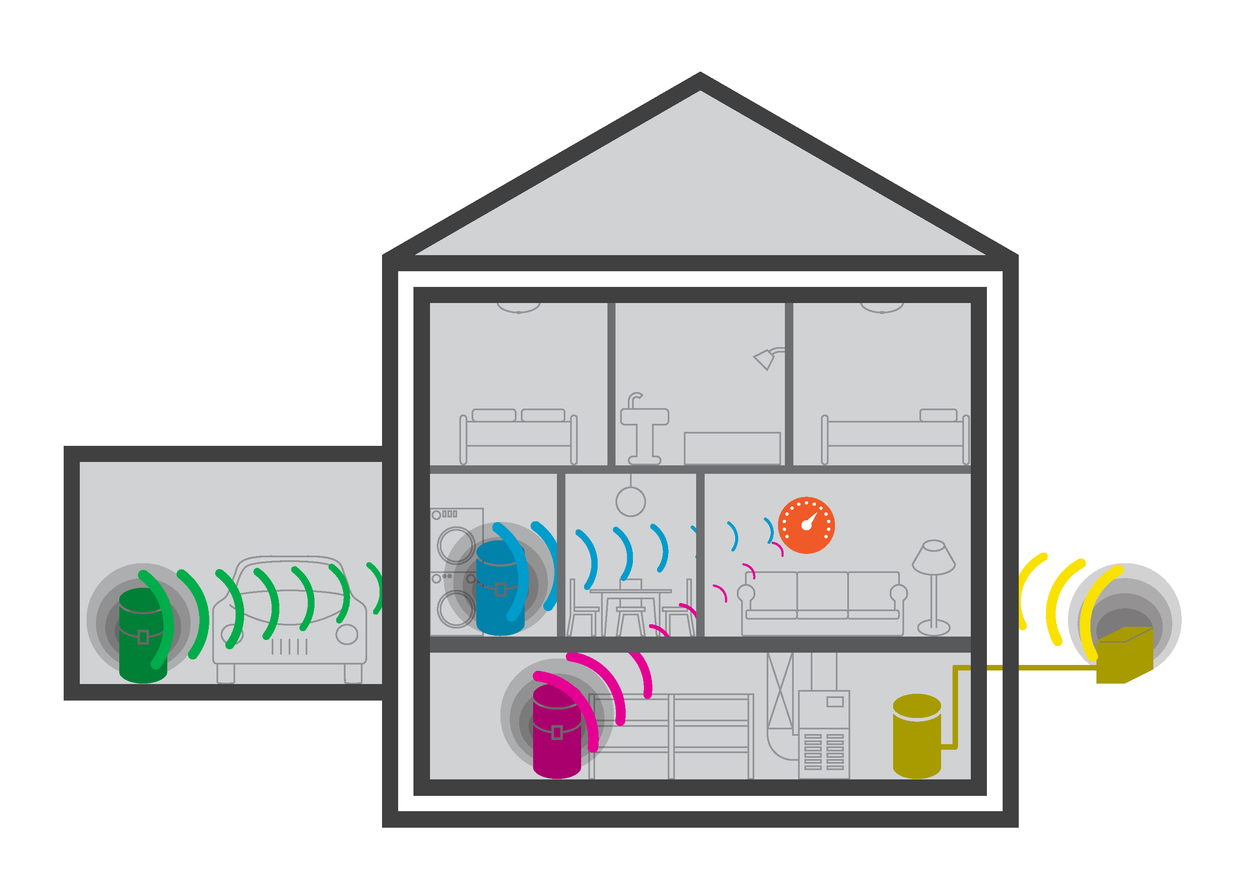
Space Heat Interaction
Space Heat Interaction [1]
Fully-Conditioned Space
Mainfloor Utility Closet, Laundry Room
Cooling effect is largely limited to rooms where HPWH installed, and typically sufficiently isolated from thermostat to have minimal effect on space heating system.
Effect further limited by HPWH’s ability to capture excess heat (heating shoulder season, solar gains, latent heat).
Split-System HPWH
Heat pumps installed outside a house have no measurable impact on space conditioning.
Non-Conditioned Space
Garage, Attic, Exterior Storage Closet
No noticeable impact on space-heating system. Heat is replaced from outside.
Semi-Conditioned Space
Basement
In spaces within insulated building envelope but not actively heated, feedback to space heating system is limited even further than in fully conditioned spaces.
[1] Ben Larson, Larson Energy Research
Notes:
P0035
Point of Slide: Highlight space heat interaction study and results

Slide 14
Installation Considerations: Open Basement
Generally, basements are above minimum volume requirements
Direct exhaust air away from walls in proximity of unit
Direct exhaust away from routine activities such as washing machines
Drain condensate to floor or other drain
If unit is located near an existing air handler that utilizes a condensate pump to dispose of condensate, the existing pump can additionally be utilized for the condensate produced by EHWHs
Notes:
P0064
Purpose: Recommend installation considerations for an open basement.

Slide 15
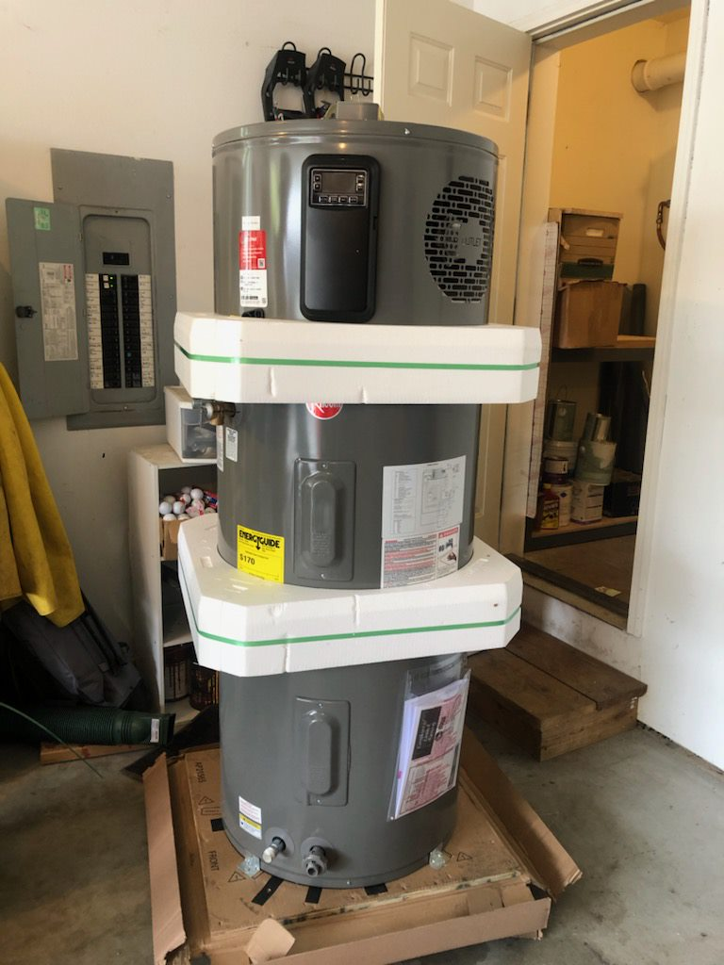
Installation Considerations: Garages
In the Northwest, garages are generally well insulated and stay above 35 degrees, except in extreme conditions
Top or side plumbing not an installation consideration, as space is generally not a limiting factor
Often require no ducting or ducting considerations
Drain condensate to the nearest drain location or directly outside
If installing on interior facing wall, sound absorbing material such iso pads and foam pipe insulation can be installed to minimize the mechanical transfer to the wall
Install sound absorbing materials before cinching down seismic strapping
Bring and install insulation pad
Notes:
P0066
Purpose:

Slide 16
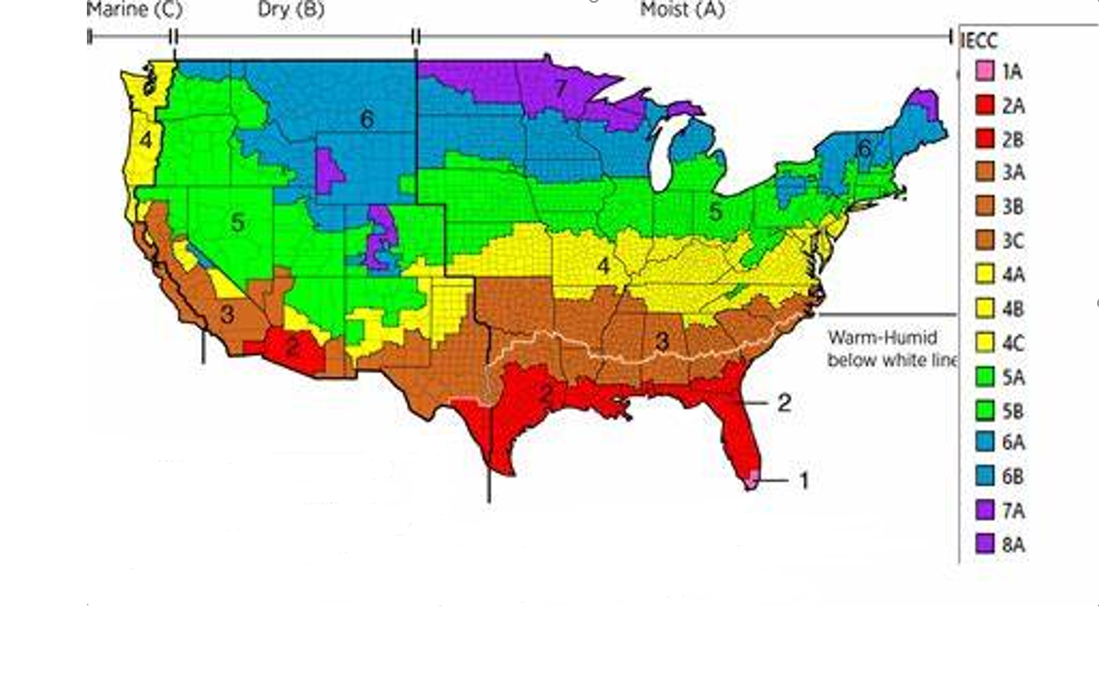
Cold Climates Zones
If a consumer lives in a “cold climate”, or climate zones 6 and 7 (as indicated by blue and purple on the map), basements are excellent locations for tank installations. Ducting using outside air would result in long periods of operation as a standard tank and decrease energy savings.
All of Alaska is in Zone 7 except for the following boroughs in Zone 8:
Bethel, Northwest Arctic, Dellingham, Southeast Fairbanks, Fairbanks N. Star, Wade Hampton, Nome, Yukon-Koyukuk, North Slope
Zone 1 includes Hawaii, Guam, Puerto Rico, and the Virgin Islands
IECC Climate Zones (homerenergy.com)
Notes:
P0053
Point of Slide: Introduce and define cold climate territories for reference in following slides

Slide 17
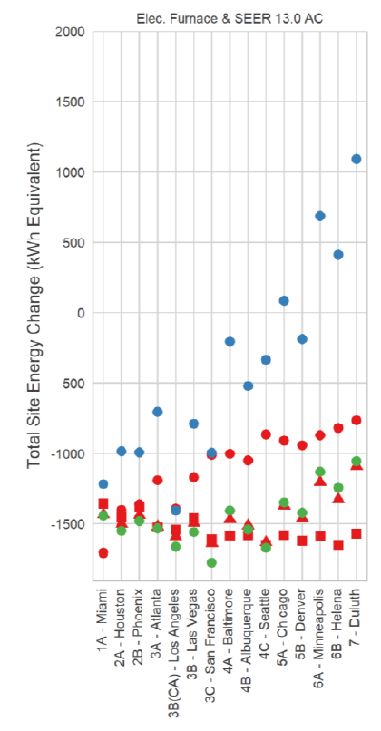
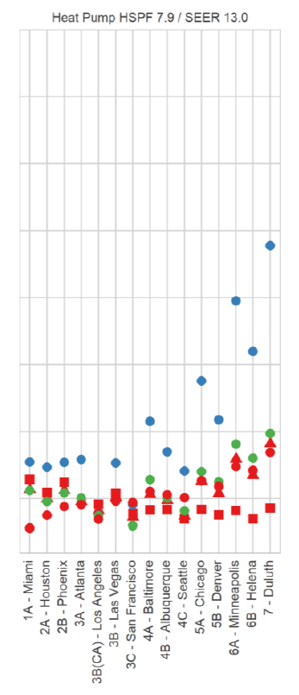
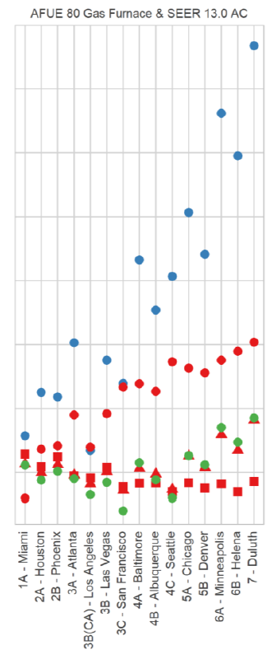
Exhaust-Only Ducting Energy Savings Comparison
The graph shows the energy penalty of exhaust only ducting in cold climates. The cities in the study range from the warmest in Miami, Florida, to the coldest in Duluth, Minnesota. The vertical axis indicates the overall impact on a home's energy use, including the heating and cooling system using various tank locations and ducting strategies. Any marks above the 0 on the vertical axis indicate an overall increase in household energy use.
Interior Exhaust-only
Interior – No Ducting
Interior Dual Ducting
Basement Exhaust-only
Basement – No Ducting
Basement Dual Ducting
Garage Exhaust-only
Garage – No Ducting
Garage Dual Ducting
*Research conducted by Sarah Widder, Cadeo Group LLC, Ben Larson, and Ecotope, Inc in “The HPWH Handbook: Optimum Installation Practices and Answers to Lingering Research Questions”
Notes:
P1090

Slide 18
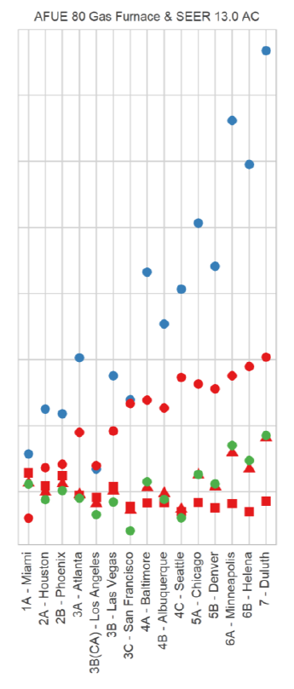
Exhaust-Only Ducting Energy Savings Comparison (cont.)
This portion of the model focuses on homes with a mid-efficiency gas furnace and a mid-efficiency air conditioner. The assorted colors and shapes of the marks indicate various tank locations and ducting methods, if utilized to overcome volumetric constraints.
Focusing on the blue dots, the results indicate in all locations there is an energy penalty when exhaust only method is utilized; and in colder climates the effect is large enough to increase total energy use within the household. During exhaust only ducting, a Heat Pump Water Heater draws conditioned or semi conditioned air from inside the house and exhausts it outside. This significantly drives up the infiltration load of the house, causing the home's heating and cooling system to operate longer to work to condition the air leaking into the house that is replacing the air being exhausted. In winter climates such as in Portland, Oregon or Seattle, Washington, exhaust only ducting would significantly reduce energy savings by over 1,000 kWh/year, with even greater reduction in climates like Duluth, Minnesota.
Interior Exhaust-only
Interior – No Ducting
Interior Dual Ducting
Basement Exhaust-only
Basement – No Ducting
Basement Dual Ducting
Garage Exhaust-only
Garage – No Ducting
Garage Dual Ducting
Notes:
P1091

Slide 19
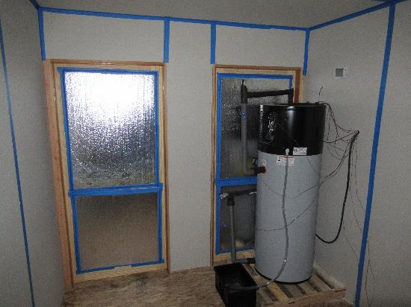
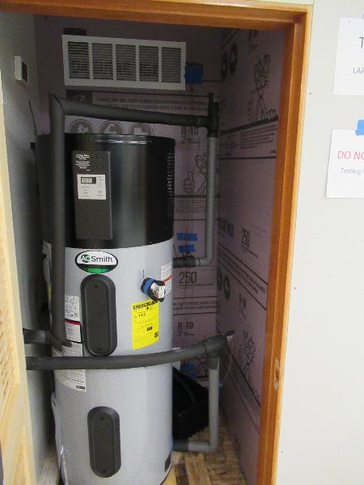
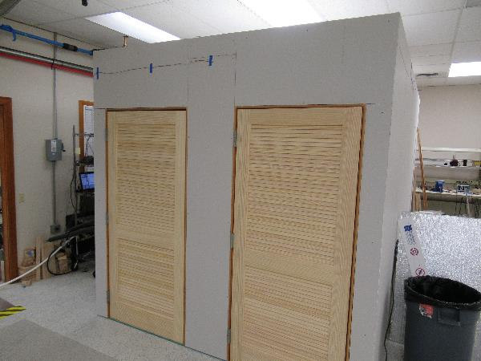
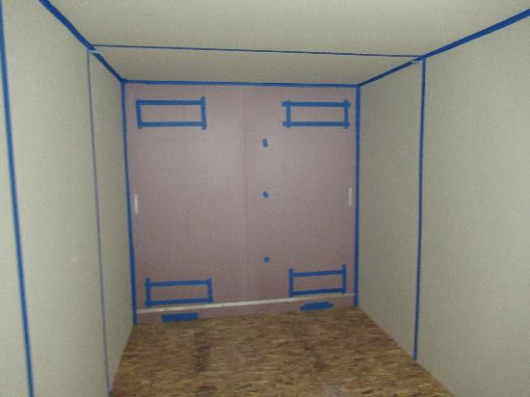
Volumetric Constraint Testing
[1] Larson Energy Research, “HPWH Performance in Small Spaces Lab Testing Update”
Notes:
P0067
Point of Slide: Introduce “Shrinking Room Experiment”, and explain study conditions

Slide 20
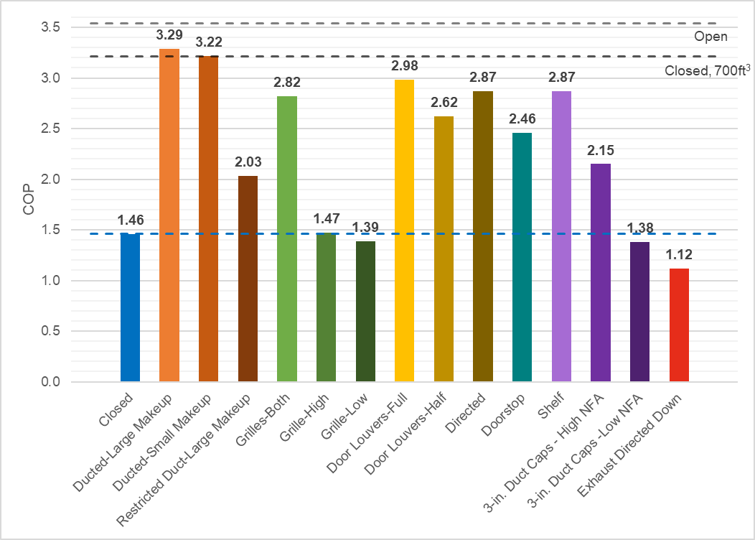
Volumetric Constraint Testing (cont.)
COP measured, with 72 ft³ space and medium draw profile
3.54 Tested upper limit in open space
3.21 Implied acceptable COP by manufacturer install requirements
10%
20%
30%
Anything below this line is worse than doing nothing.
[1] Larson Energy Research, “HPWH Performance in Small Spaces Lab Testing Update”
Notes:
P0068
Point of Slide: Detail Amelioration Method Assessment and findings

Slide 21
Volumetric Constraint Testing (cont.)
[1] Larson Energy Research, “HPWH Performance in Small Spaces Lab Testing Update”
Notes:
P0069
Point of Slide: Provide insight and explanation into the results of the Shrinking Room Experiment

Slide 22
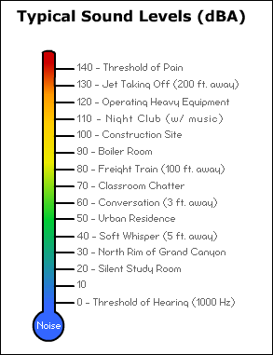
Noise
Average EHWH
Heat pump water heaters range in decibel ratings of 45 to 52 decibels.
About the same level as a modern dishwasher.
The decibel scale is logarithmic.
A decibel increase of 10 represents a doubling of perceived loudness.
Notes:
P0083
Point of Slide: Explain noise scale and provides real-world comparisons for relativity

Slide 23
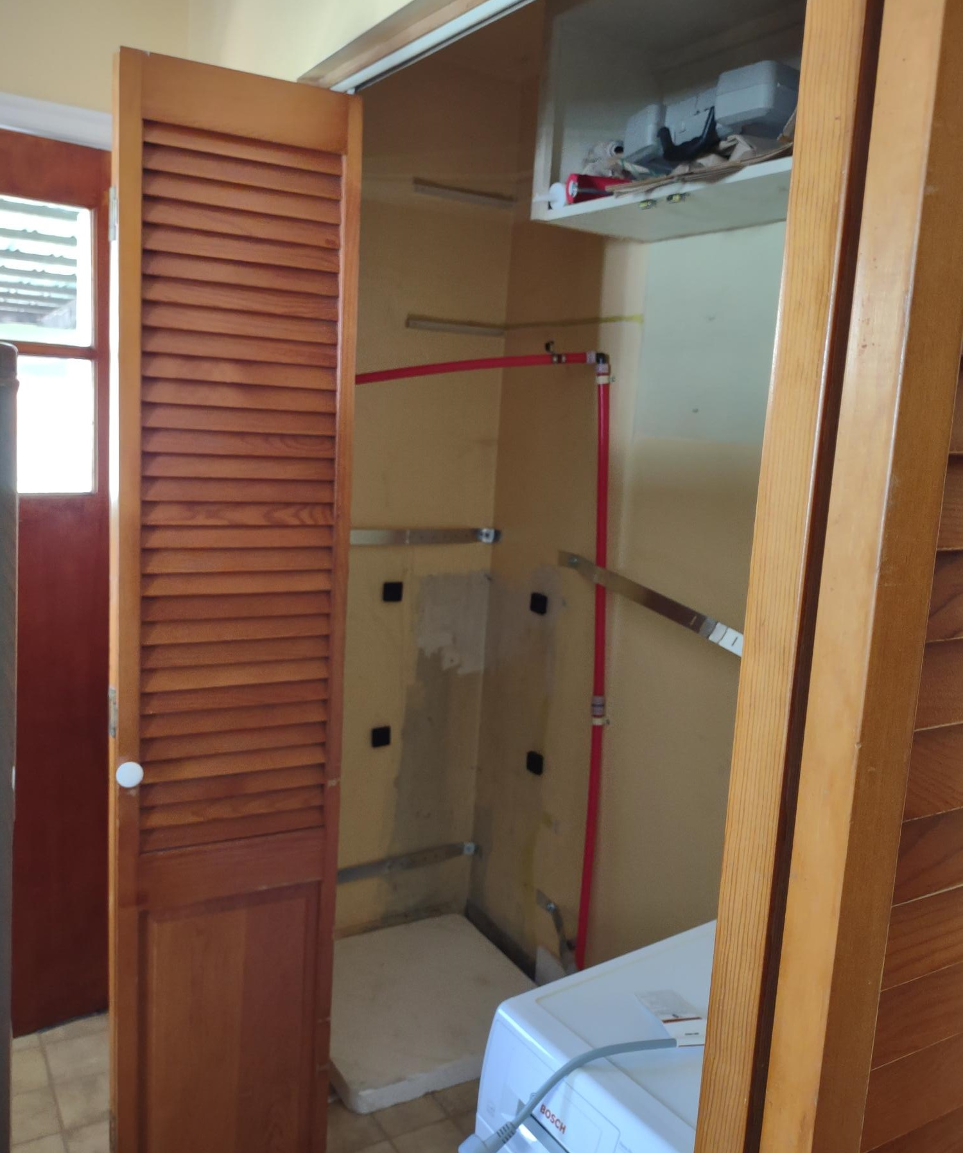
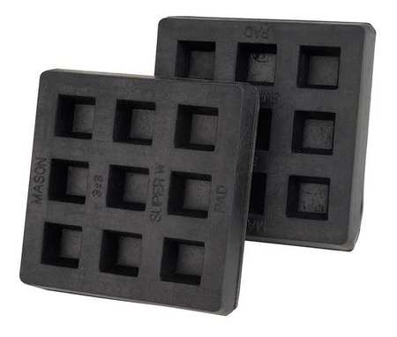
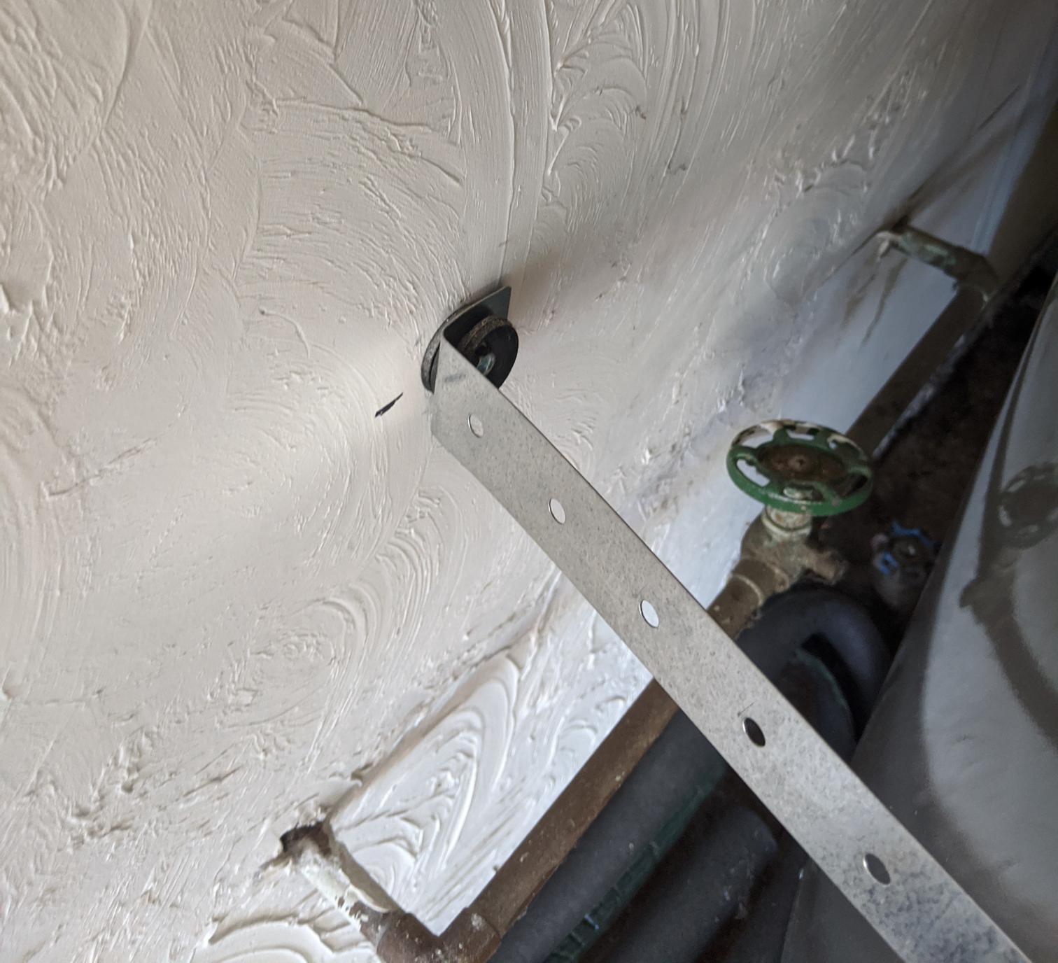
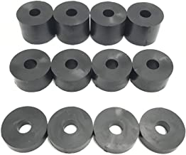
Noise Mitigation
Low-Noise Tips for Installation:
Choose the right location for installation
Don’t put in high occupancy areas where the noise will become bothersome to the homeowner
Seismic strapping considerations:
If installing in an area that requires seismic strapping, the vibration from the tank will travel through the wall and echo
Example: Isolation pads are an option to further reduce noise and vibrations between EHWH and two walls.
Neoprene washers or stand-offs are used to anchor seismic straps.
Washer used on both sides of the strap.
Notes:
P1063
Point of Slide: Provide recommendations for low-noise installation, and seismic strapping considerations.

Slide 24
Brand Naming Convention
Different operational modes can be selected via the HPWH control panel, or app with some models. The differences in the naming of the modes, by brand, are outlined below.
Manufacturer | Manufacturer Naming Convention
 | Allows only the compressor to operate | Allows elements to engage | Allows elements to engage earlier in the cycle | Electric elements only | Vacation
A. O. Smith | Efficiency | Hybrid | --- | Electric | Vacation
Rheem | Heat pump | Energy Saver | High Demand | Electric | Vacation
Bradford White | Heat pump | Hybrid Standard | Hybrid Plus | Electric | Vacation
Notes:
P0096
Point of Slide: Displays the difference in operational mode nomenclature amongst different manufacturers

Slide 25
Thank You
For more information, visit Hot Water Solutions or reach out to us with questions at info@hotwatersolutionsnw.org or by phone at (888) 444-8962.
Notes:
P0131
Point of slide: End of Training – Call to Action

